Slide 1

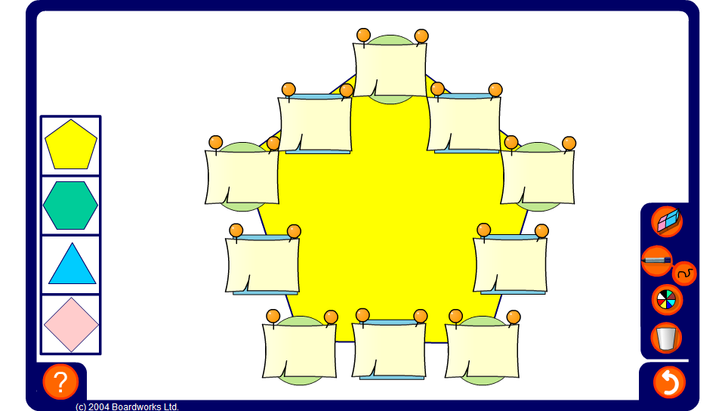


Productagons – using factors
Notes:
Use the productagon on this slide to practise multiplying and dividing using factors. Press reset for a new puzzle or change the shape of the puzzle by selecting one of the shapes on the left.

